Slide 1

CSE-5335: WEB DATA MANAGEMENT
TEAM-5
Dishant Krishna Koli (1002067615)
Shivang Khatri(1002117821)
Sri Krishna Priya Karri(1002114299)
Rohith Kavuri(1002087346)
Tejaswi Kundur(1002120036)
dxk7615.uta.cloud
Section: 5335-001
SUMMER 2023

Slide 2

Understanding URM (Underrepresented Minority)
Definition:
URM stands for Underrepresented Minority.
It refers to racial and ethnic populations that are underrepresented in a particular area or field relative to their numbers in the general population.
Importance:
Diversity: Incorporating URMs promotes a diverse workplace, which leads to varied perspectives and innovative solutions.
Inclusion: Recognizing and supporting URMs ensures that everyone has an equal opportunity and feels valued.
Social Responsibility: Addressing the underrepresentation of certain groups is part of an organization's responsibility to society.

Slide 3
Overview
The Pages Before Login:-
1.Home
2.About
3.Services
4.Blog
5.Contact us and
6.Login/register page
These are the pages which helps to Navigate the Basic overview of our website and gives the end user a holistic view of its purpose

Slide 4
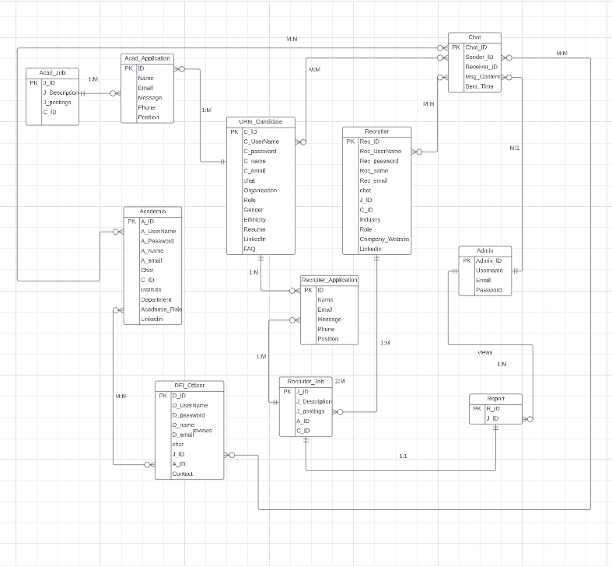
Entity Relationship Diagram

Slide 5
Technologies Used
HTML : CSS
REACT
WORDPRESS
PHP: NODEJS: MYSQL
LARAVEL

Slide 6

PHASE 4 Demo

Slide 7
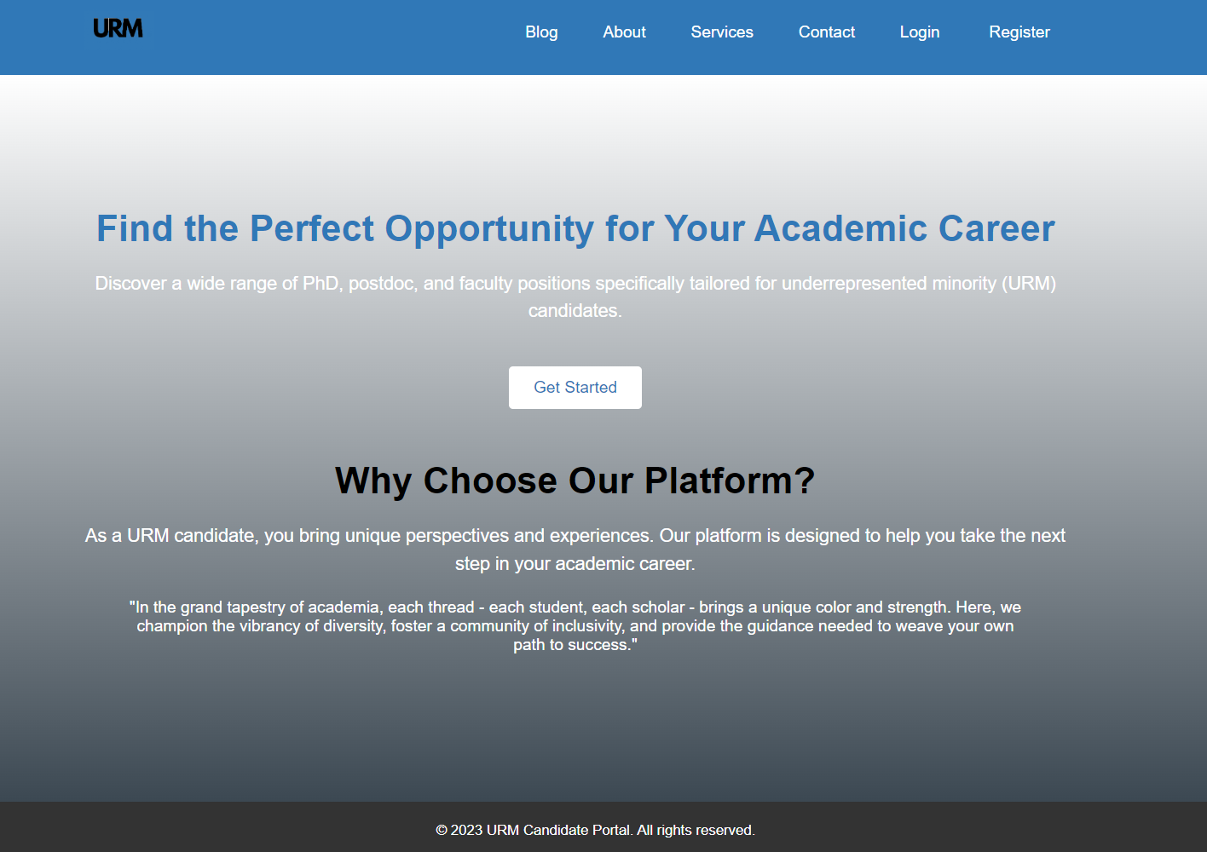
HOME PAGE

Slide 8
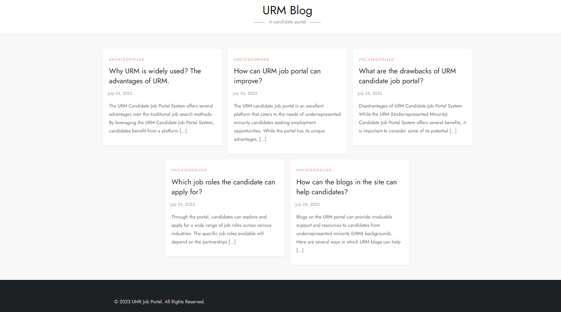
BLOG
https://sdk7821.uta.cloud

Slide 9
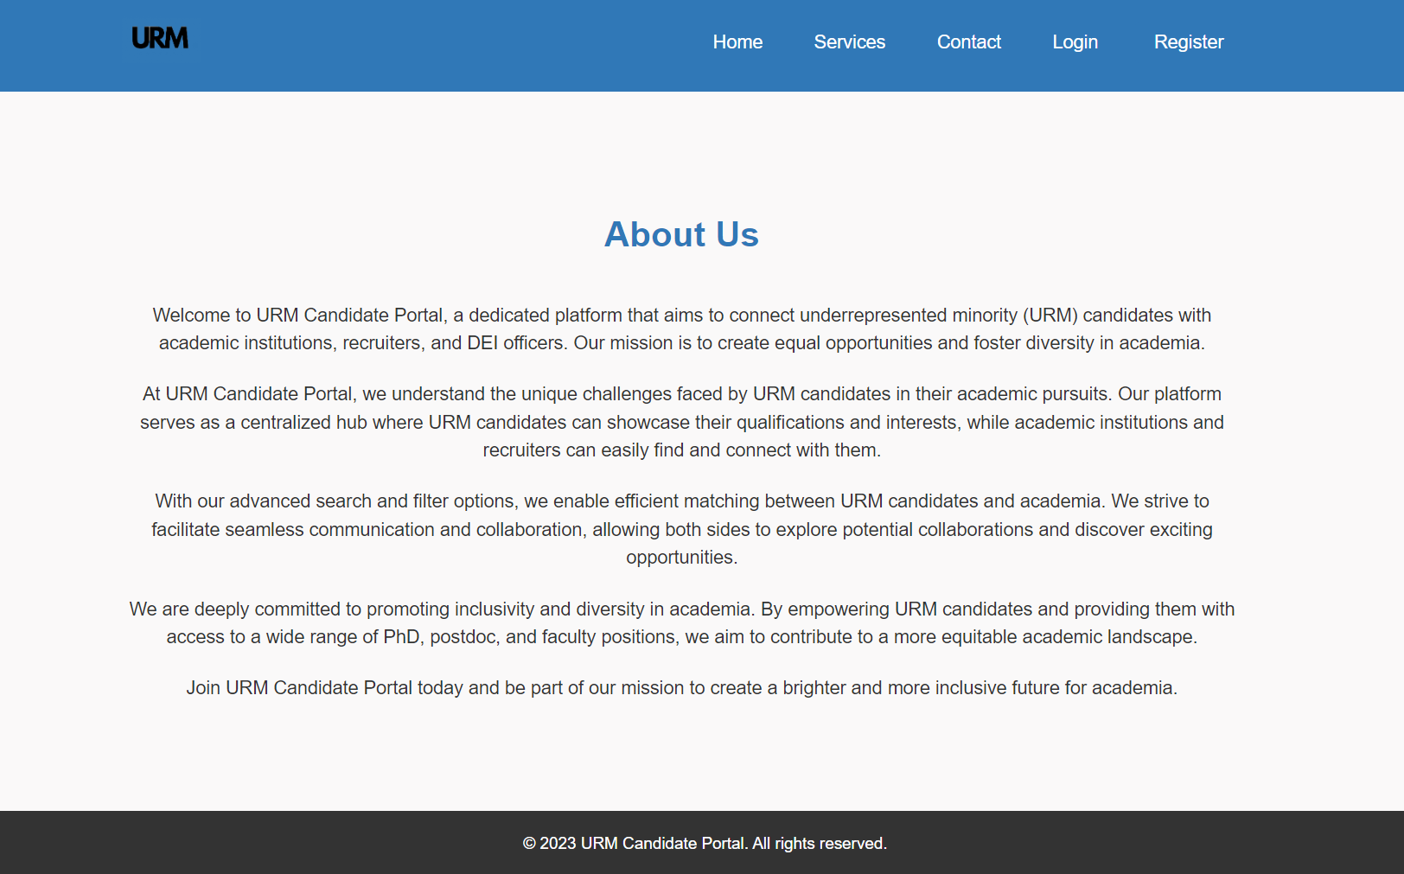
ABOUT US

Slide 10
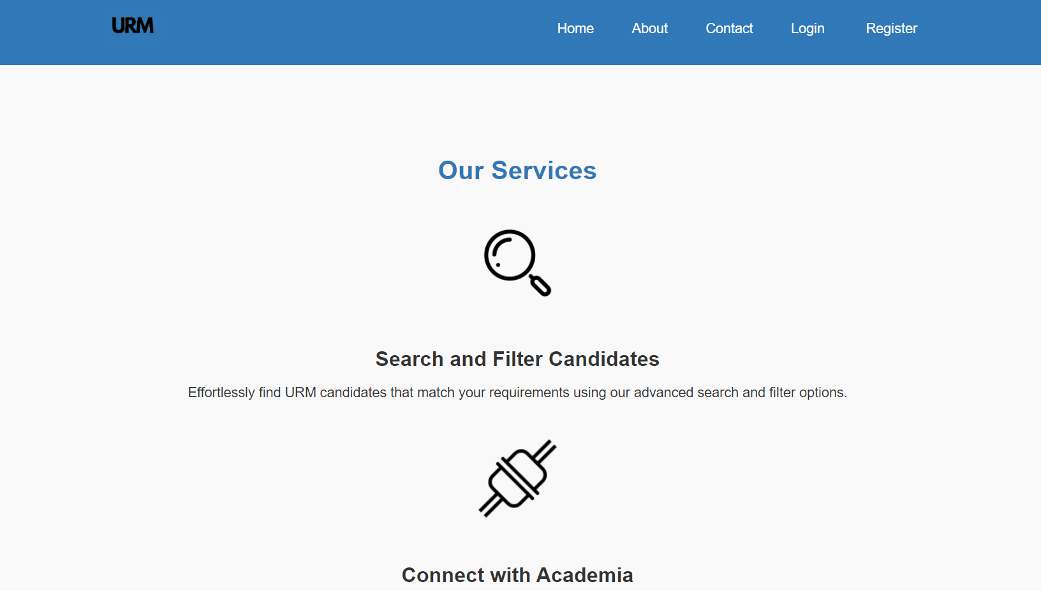
SERVICES

Slide 11
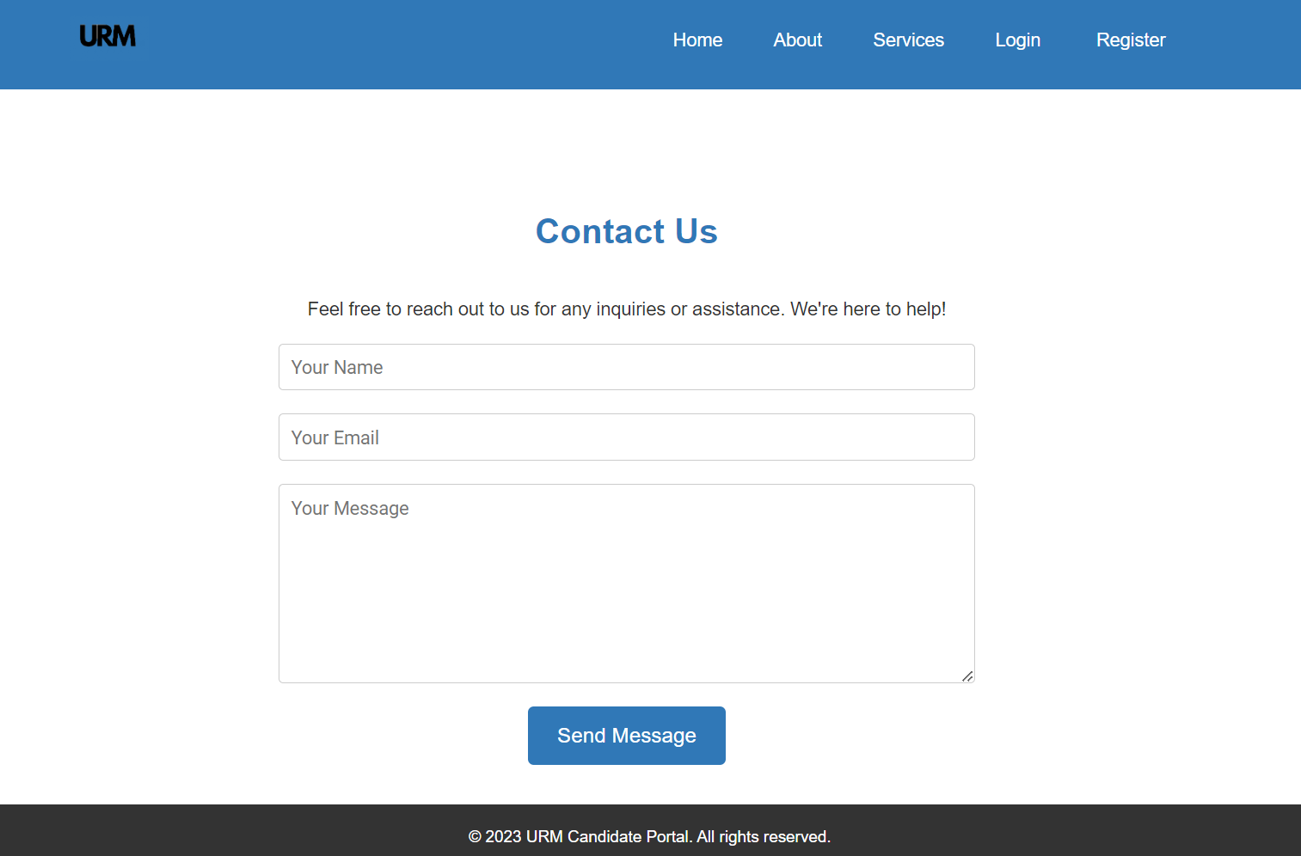
CONTACT US
Reach out to us for any inquiries or feedback.
We're here to help and value your input. Connect via email, phone.

Slide 12
LOGIN AND REGISTER PAGE
The "Register" option leads to multiple registration pages, including those for Academia, URM Candidate, DEI Officer, and Recruiter. Users must first complete the registration before accessing the login page to view their dashboard. The login page requires an email, password, and user role for authentication.
Upon successful login, users are presented with dashboards tailored to the specific roles they've logged into, such as:
Candidate
DEI Officer
Academia
Recruiter
Admin

Slide 13
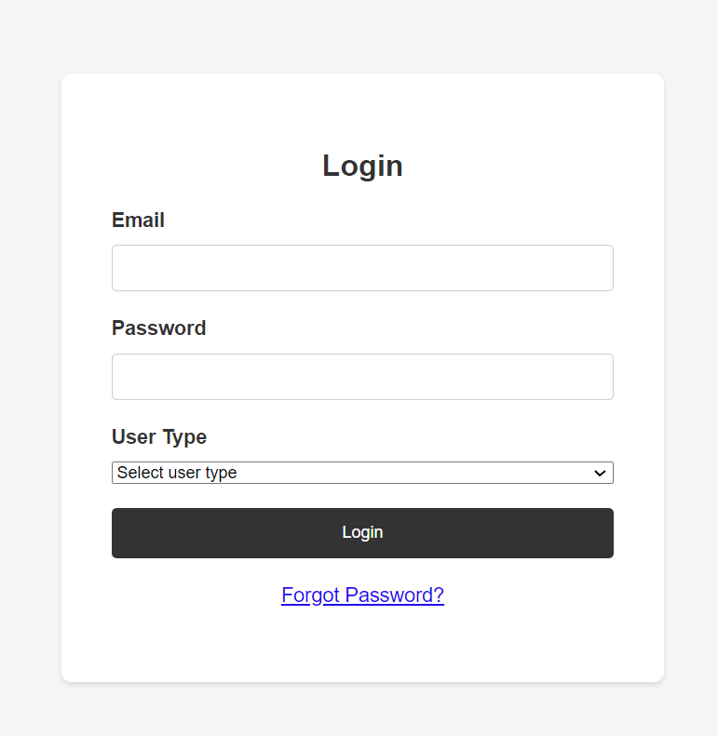
There is a unified login page for all users.
On this page, users are required to specify their
role to access the corresponding section.

Slide 14
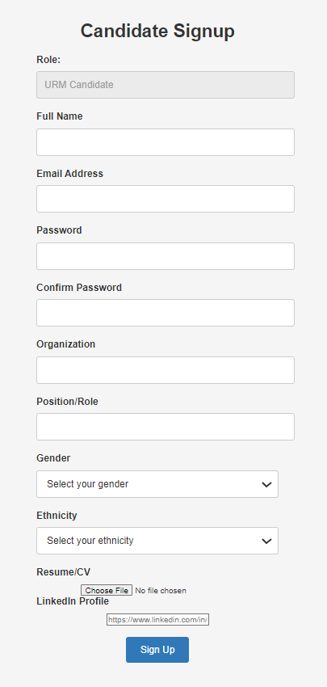
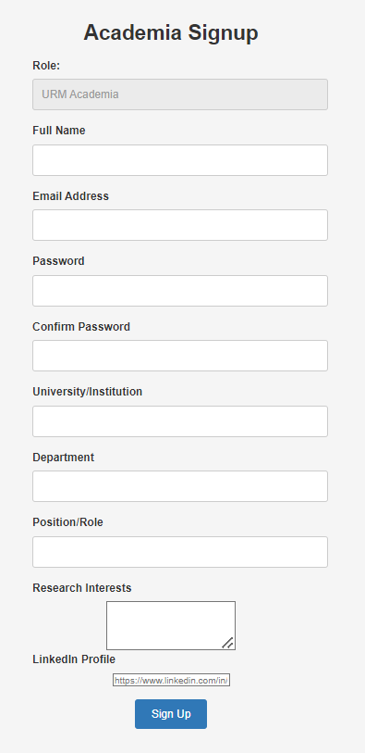

Slide 15
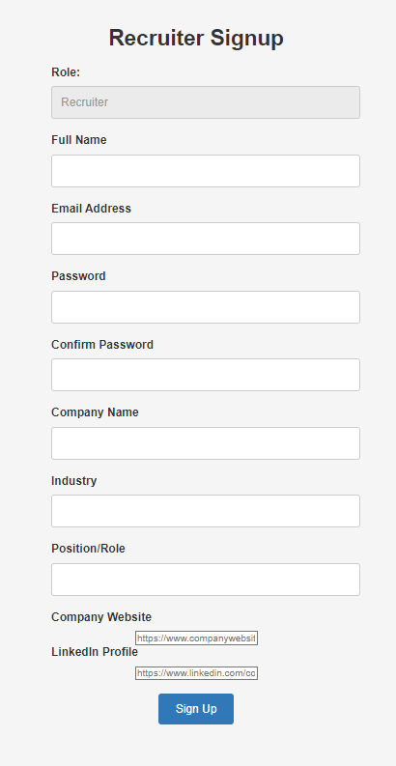
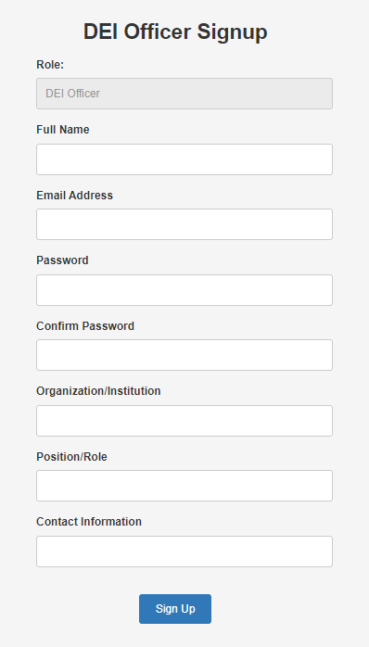

Slide 16
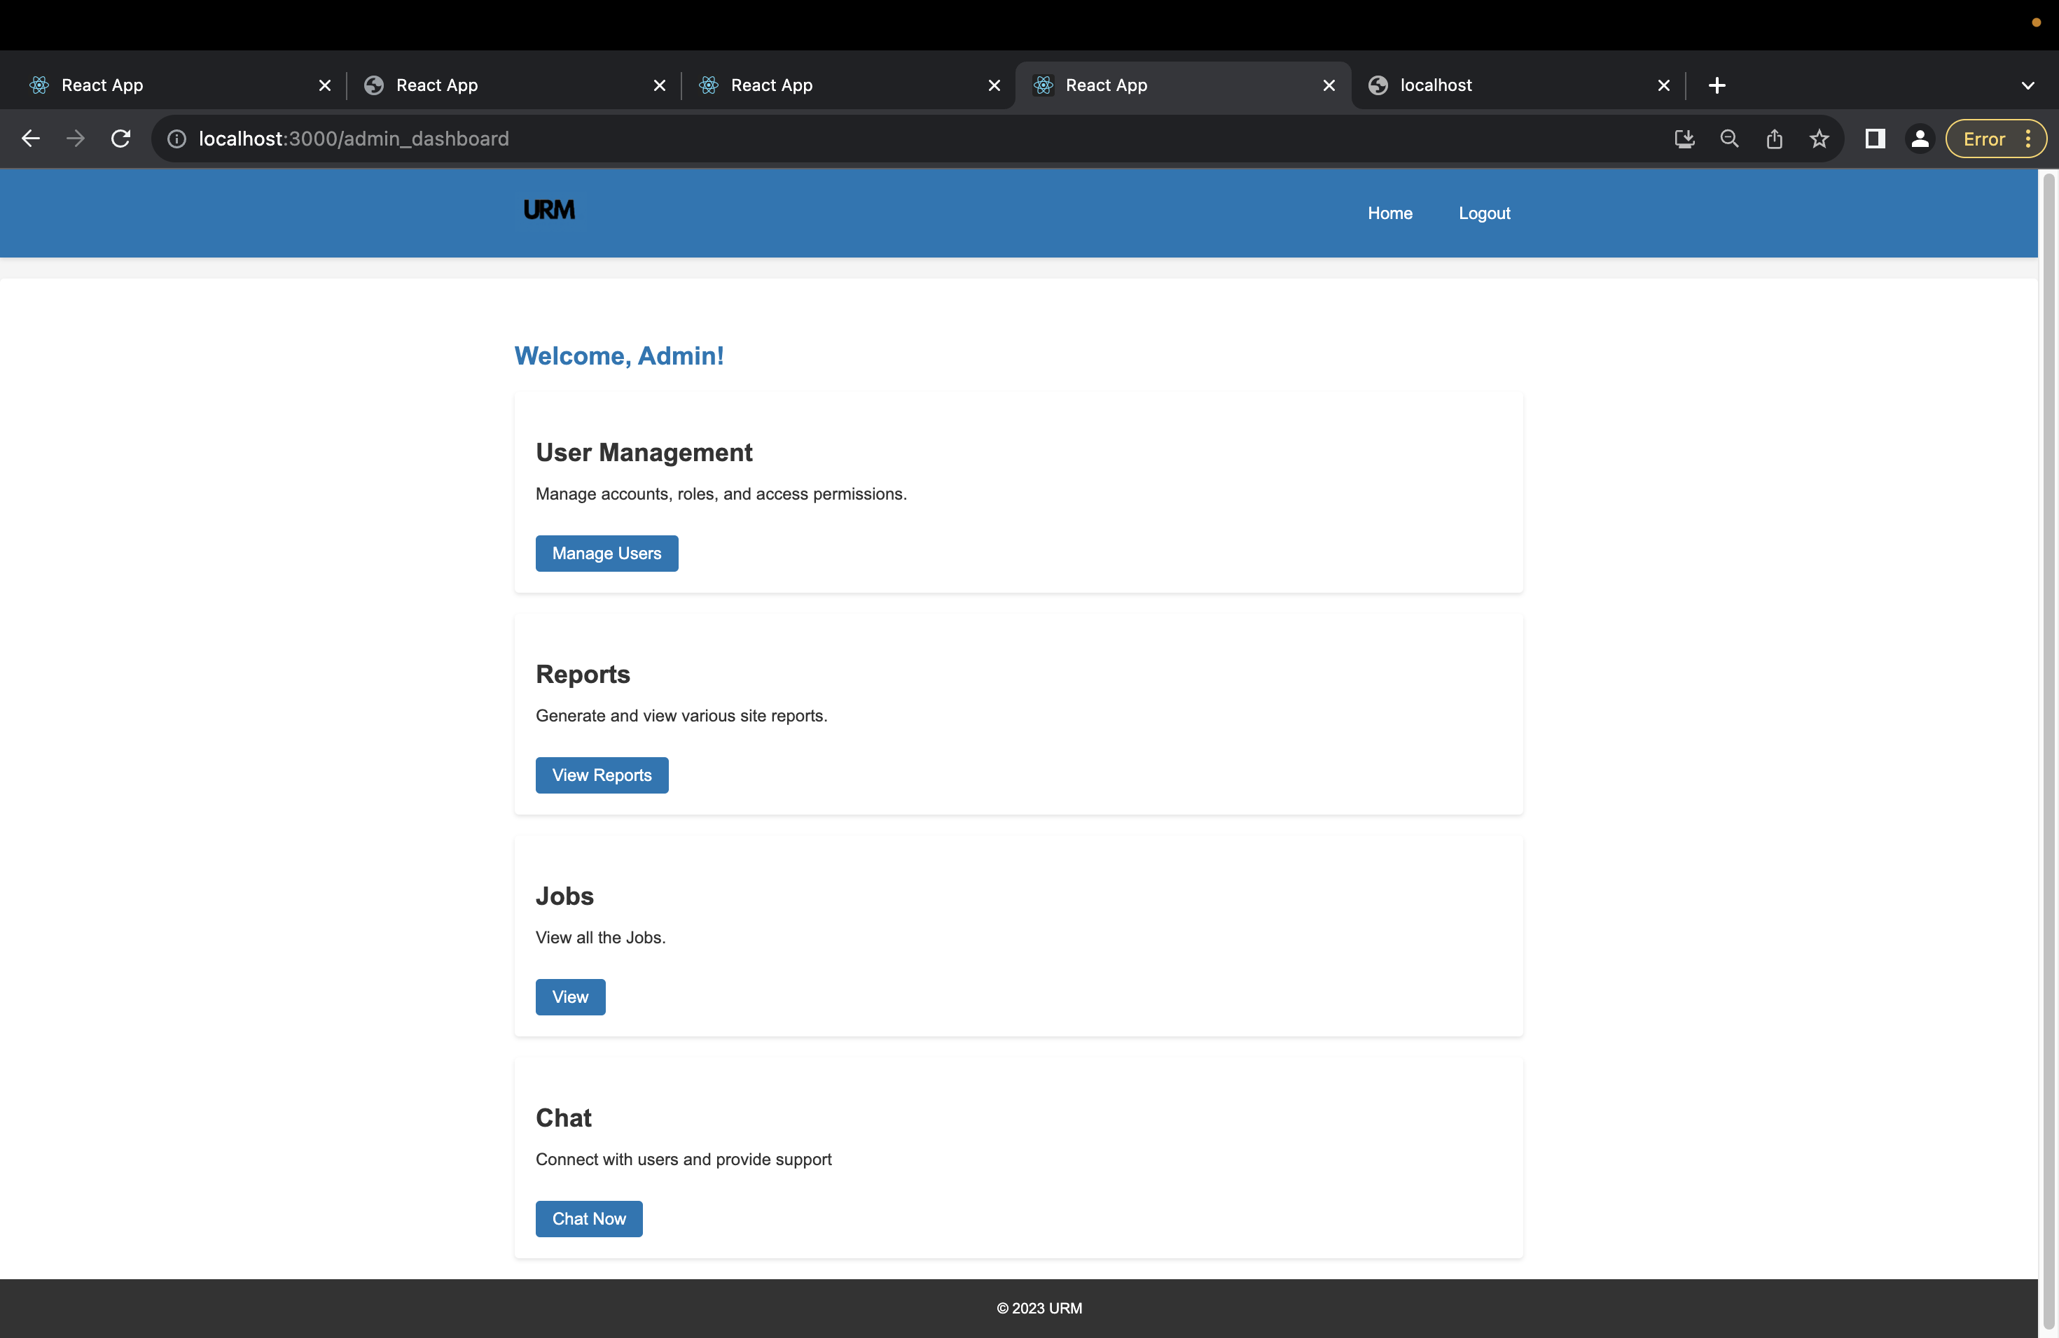
ADMIN DASHBOARD
Admin Dashboard shows the options for User management, viewing different type of reports, List of all jobs and chat option to chat with anyone.

Slide 17
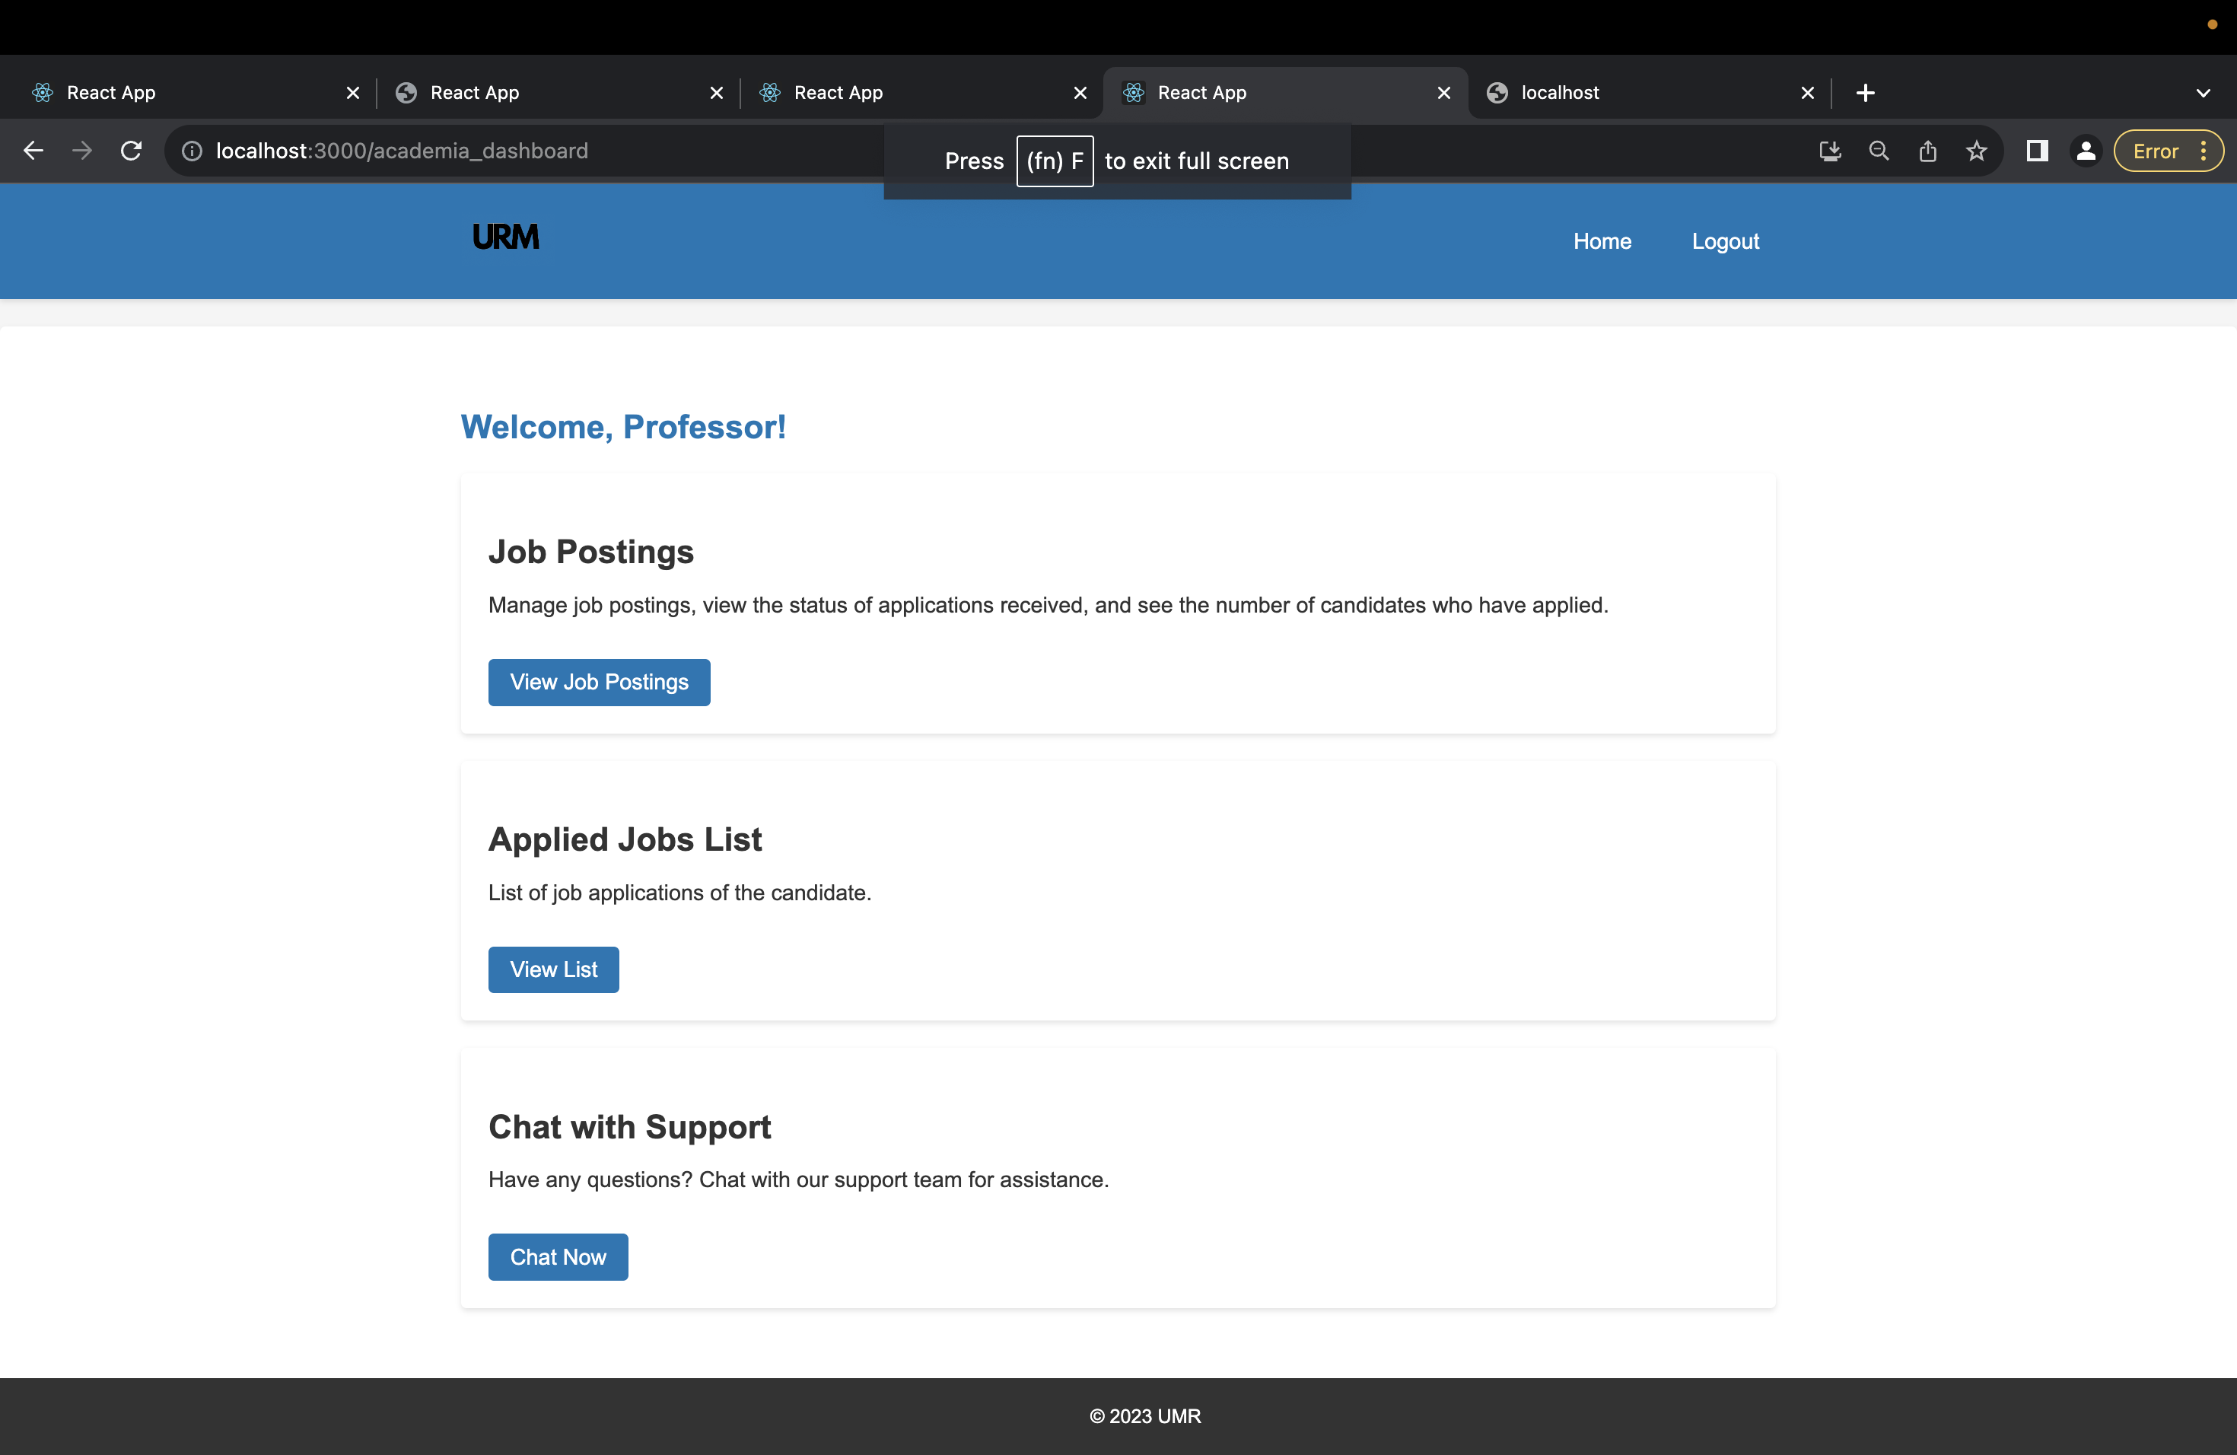
ACADEMIA DASHBOARD
The Academia Dashboard offers features to post new job listings, view received job applications, and provides a chat feature to communicate with Candidates and DEI officers.

Slide 18
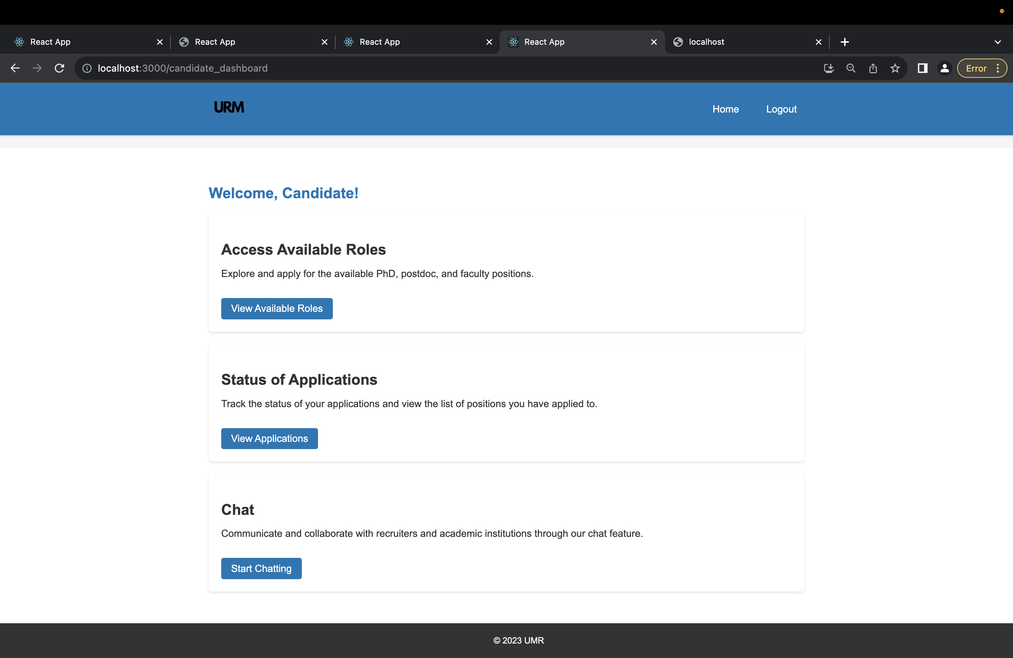
URM CANDIDATE DASHBOARD
A candidate's dashboard have options to view the available job openings, check the application status and chat option to chat with academia, recruiter, DEI officer.

Slide 19
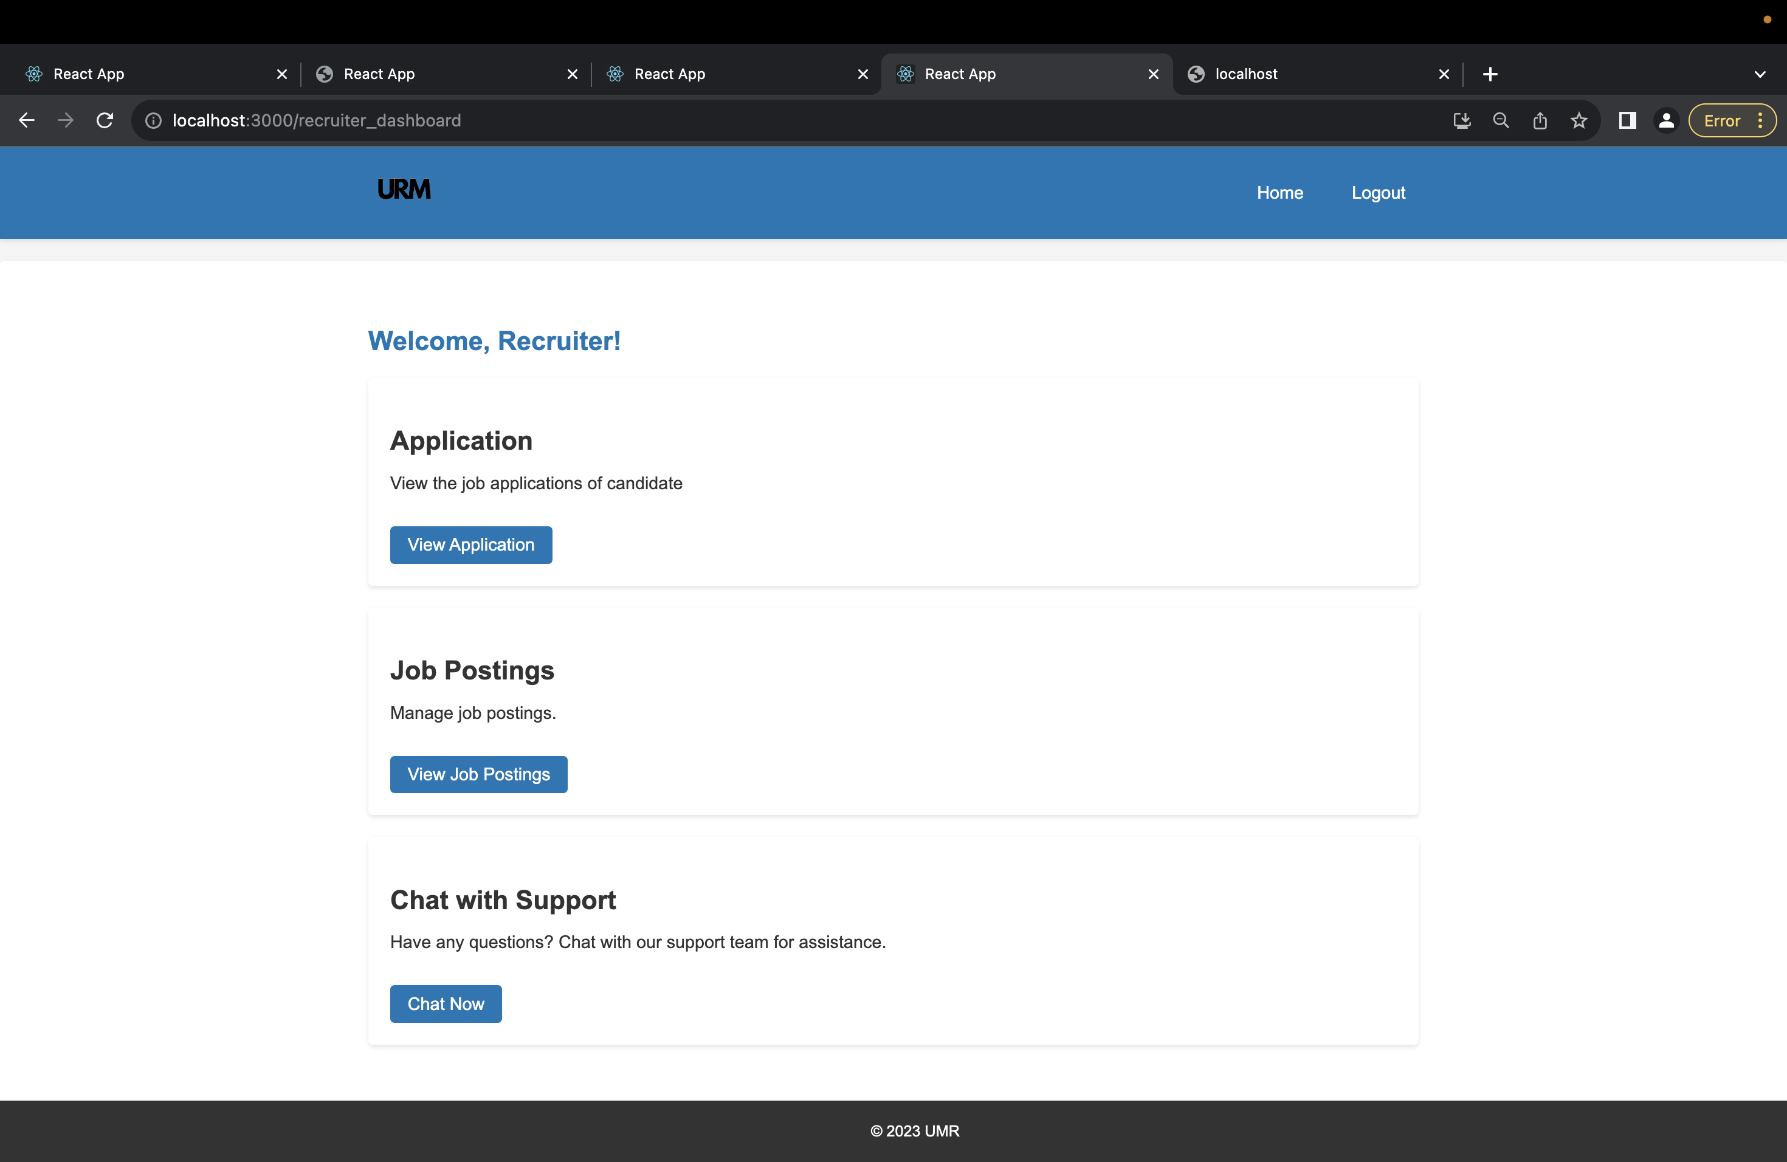
RECRUITER DASHBOARD
Recruiter Dashboard presents the options of posting a new Job, Viewing the list of Applications list and a chat option to chat with Candidates, DEI officer

Slide 20
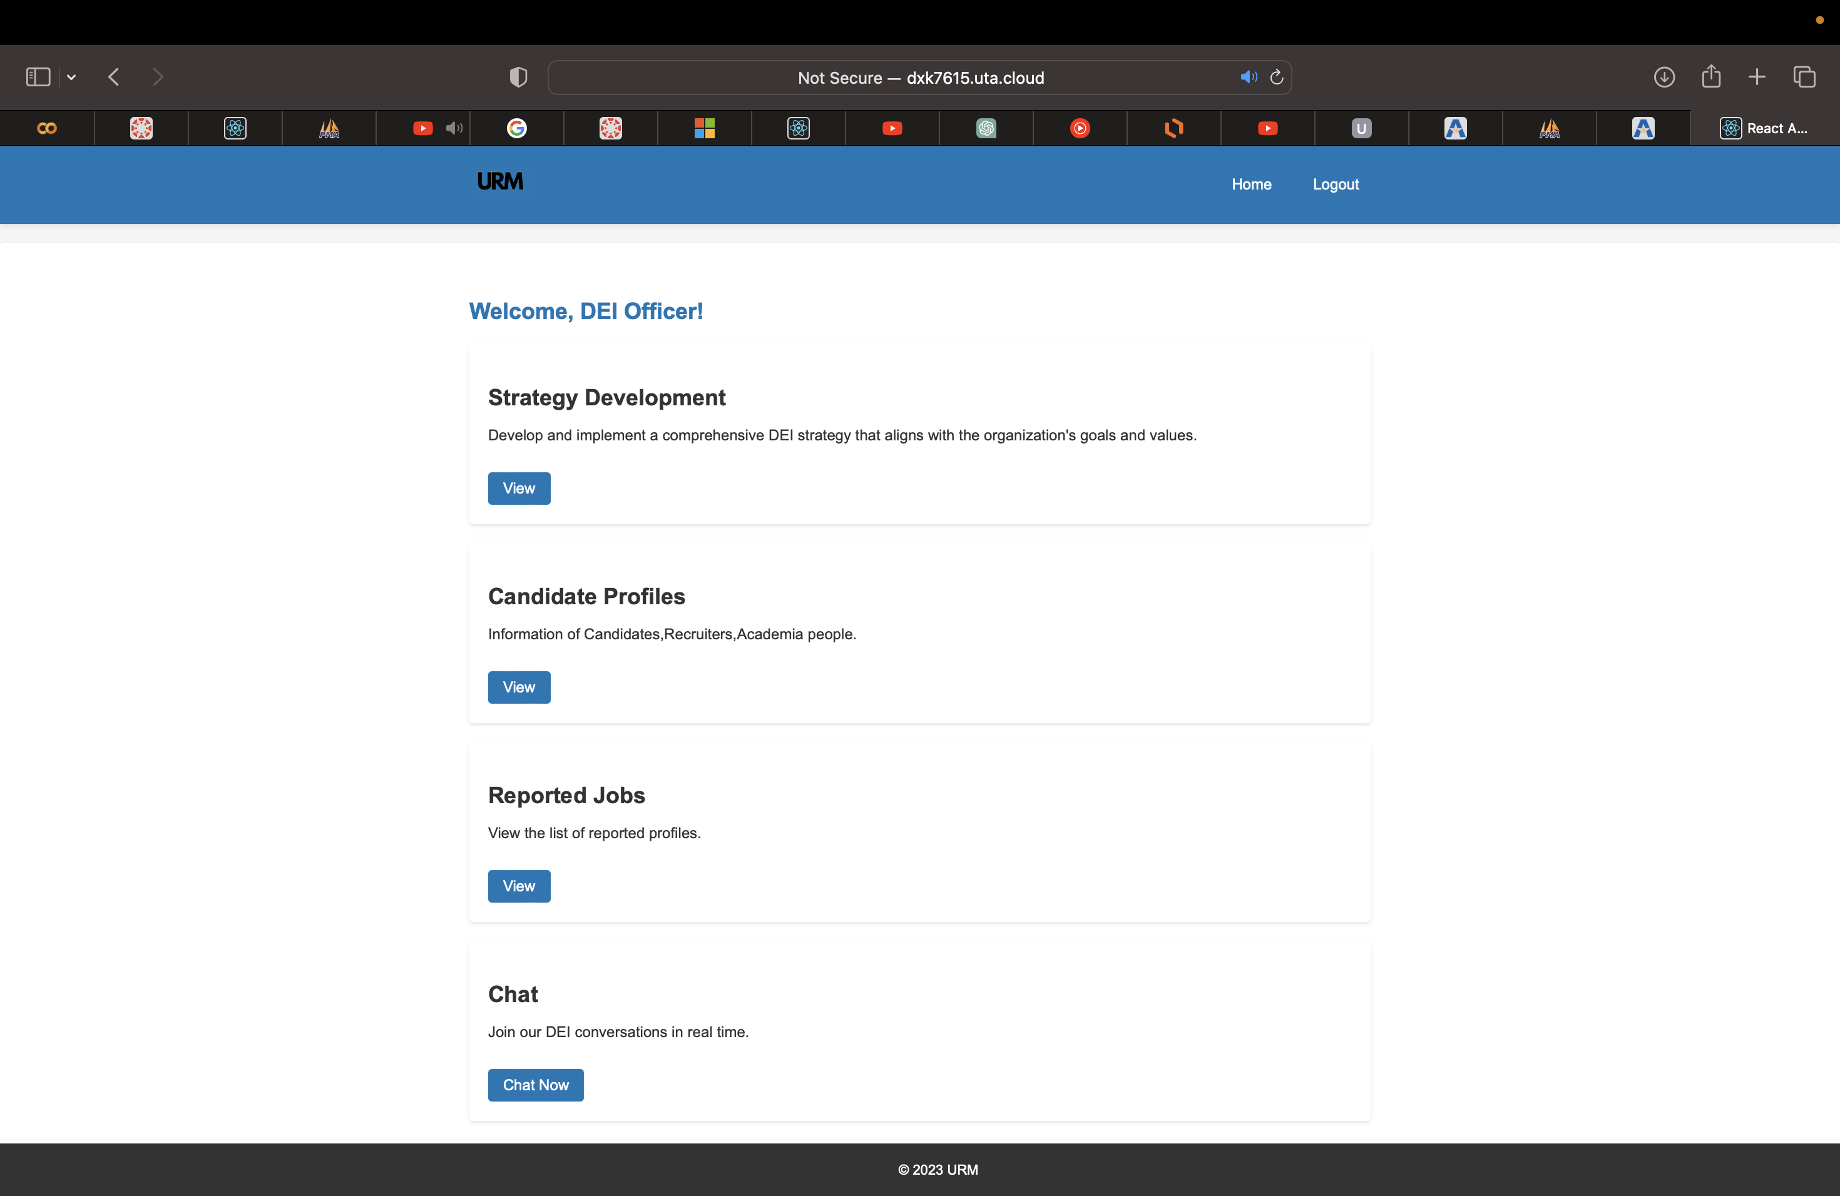
DEI OFFICER DASHBOARD
DEI officer dashboard has the options for viewing the rules regarding URM, View candidate profiles, view the list of reported jobs against discrimination and chat option to chat with academia, recruiters, candidates.

Slide 21
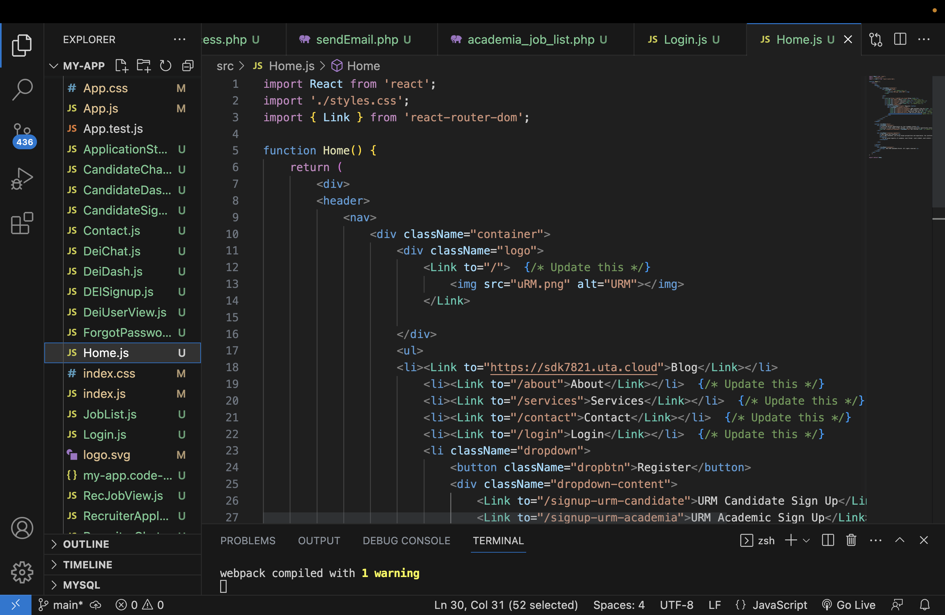
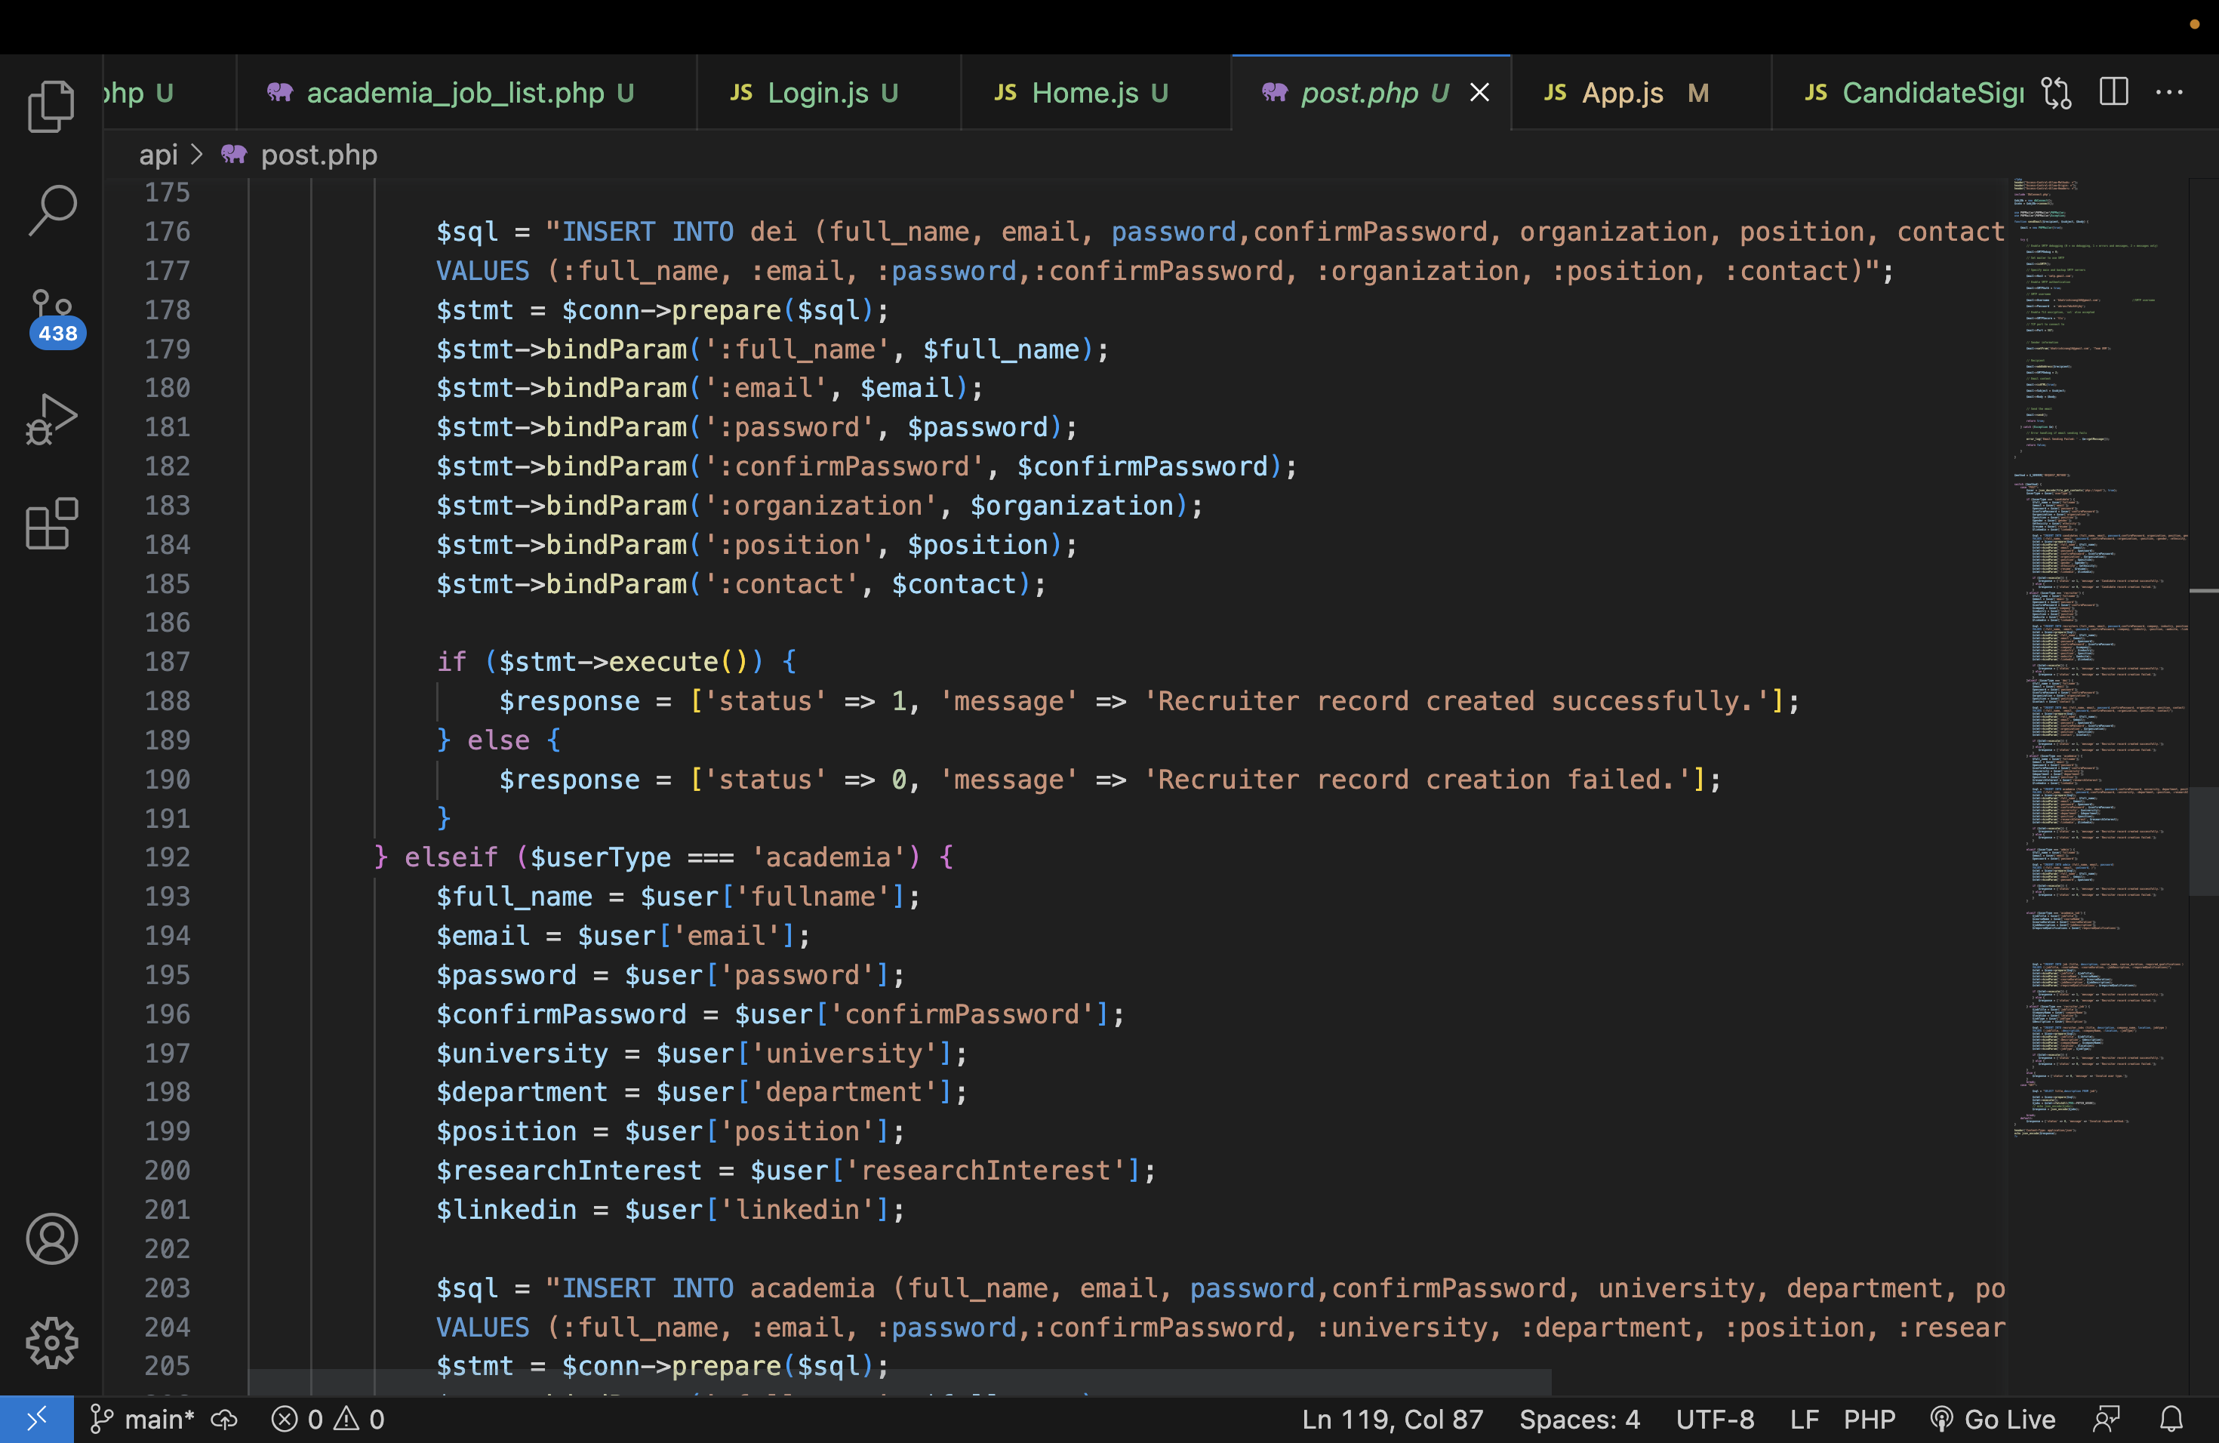
CODE SNIPPETS

Slide 22
Challenges Faced
React JS Transition: Initially, we built a static site with HTML and CSS. Shifting to React JS was challenging due to our team's novice familiarity with it, but we overcame it through teamwork.
Evolving to a Dynamic Site with MYSQL: Our next step was to evolve our static site into a dynamic one using React JS and integrating MYSQL for dynamic content support. This phase had its hurdles - from data retrieval to email issues - but we tackled each to ensure smooth functionality.
Incorporation of LARAVEL: The last phase involved integrating LARAVEL, a pivotal step for our project's success, which presented its own set of challenges.

Slide 23
Future Scope
Integration with Social Media:
Give users the option to link their accounts to their social media profiles. URM candidates might be able to create profiles that are more comprehensive and take advantage of better networking opportunities thanks to this integration.
Multi-language Support:
Explore offering multi-language support to appeal to a larger international audience of URM candidates and academics in order to increase the platform's impact and global reach.

Slide 24

Learnings
Describing this project in our portfolio highlights our hands-on expertise in programming languages like HTML, CSS, JavaScript, and PHP. It demonstrates our capability to craft a complete website from the ground up, encompassing both frontend and backend development, as well as database management. More than just theoretical know-how, this endeavor underscores our experiences in tackling real-world challenges and delivering functional solutions.

Slide 25

Thank You PROFESSOR DR. ELIZEBETH DIAZ

